Slide 1
Making the Case for Tobacco Treatment for Behavioral Health Clients

Slide 2






Rethink Tobacco Indiana
Rethink Tobacco Indiana aims to reduce the prevalence of tobacco and nicotine use among persons with mental health conditions, substance use disorders, or co-occurring disorders through the following free activities and resources:
Technical Assistance
Policy Development
Education
Specialized Training
Resources

Slide 3
A quick note…
Commercial tobacco use/tobacco use: The use of commercial tobacco and nicotine products (including electronic nicotine devices, otherwise known as ENDs).*
*All references to smoking and tobacco use are referring to commercial tobacco and not the sacred and traditional use of tobacco by some American Indian and Alaskan Native communities.

Slide 4

  Everyone deserves a fair and just opportunity to be as healthy as possible.
  Adults with behavioral health conditions who smoke want to quit and are able to quit – but are less likely to be offered supports that are proven to help people quit for good.

Slide 5
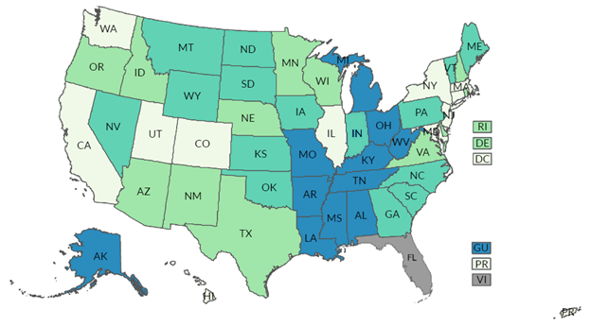
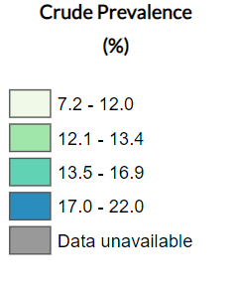
Current Cigarette Use Among Adults, Regional Trends, BRFSS 2022
IN = 16.2%
Nearly 70% of adults who smoke want to quit
CDC, National Center for Chronic Disease Prevention and Health Promotion, Division of Population Health. BRFSS Prevalence & Trends Data [online]. 2021. [accessed Feb 13, 2023]. URL: https://www.cdc.gov/brfss/brfssprevalence/.
Notes:
References:
Centers for Disease Control and Prevention, National Center for Chronic Disease Prevention and Health Promotion, Division of Population Health. BRFSS Prevalence & Trends Data [online]. 2021. [accessed Feb 13, 2023]. URL: https://www.cdc.gov/brfss/brfssprevalence/.

Slide 6
Current Smoking: 2022 Demographics
Rates of smoking were significantly lower among adults who are females, Hispanic racial group and those who are 18 to 24 and 65 or older
Note: Race and ethnicity are treated as mutually exclusive categories.
Notes:
About Slide:
The BLACK line you see across the chart is the overall smoking rate for Indiana (16.2%).
In 2022, female smoking rates were significantly lower than males. Smoking rates were significantly lower among Hispanic racial group compared to Whites, African American and multiracial race group. There were significantly lower rates of smoking among those ages 18-24 and 65 years or older. The highest rates of smoking were seen among those ages 25-64.

Slide 7
Current Smoking: 2022 Demographics
Individuals with lower levels of completed education and lower annual household income reported smoking at significantly higher rates than those with higher education attainment and household income.
Notes:
About slide:
In 2022 we saw that those with less than a high school education, had significantly higher rate of smoking than any other level of education attained. Those that had a college education had a significantly lower rate of smoking than any other level of education attained. We also saw that in general, the rate of smoking decreased as the reported household income level increased. Also, those with income less than $15,000 had a significantly higher rate of smoking compared to the other income levels.
I want to highlight that what we are seeing here is because of direct targeting by the tobacco industry. We know that the tobacco industry advertises, discounts and displays commercial tobacco products in some communities more than others. These tailored tactics push dangerous tobacco products into the communities that have the fewest resources to deal with the health problems that come with the use of these products.

Slide 8
Current Smoking: 2022 Marginalized Populations
Hoosier adults who reported 14 or more poor mental health days or have been diagnosed with depression reported smoking at significantly higher rates.
Notes:
About Slide:
This slide provides examples of how tobacco disproportionately impacts groups facing disadvantage. These populations continue to see increased rates of smoking.
Those experiencing 14 or more poor mental health days reported smoking at a significantly higher rate than those experiencing fewer than 14 poor mental health days.
Those ever diagnosed with depression (depressive disorder) reported smoking at a significantly higher rate than those never diagnosed with depression.

Slide 9
Smoking and Behavioral Health:
The Heavy Burden
Overall, Indiana adults with a Behavioral Health (BH) condition are more likely to smoke (32% versus 15%)
  Current e-cig use is 22% versus 8%
Most common causes of death among those with a BH condition include cancer, heart disease, and lung disease – all of which can be caused by smoking.
Among Adults with Any Mental Illness (AMI)
  Adults with AMI are more likely to smoke (27% compared to 16%)
  Smoke more cigarettes (2 packs more per month)
  Smoking can impact the efficacy of prescribed therapies
Among Adults with Substance Use Disorder (SUD)
  Adults with a SUD are more likely to smoke (42% compared to 16%)
  Face challenges when trying to quit- less than half of substance abuse facilities offer tobacco treatment
  Smoking can increase the likelihood of substance abuse relapse
Sources available upon request
Notes:
Recall that Indiana has a higher smoking rate the national, which translates to a higher burden in our state with the behavioral health population.
About Slide:
Overall, adults with a behavioral health condition smoke at twice the rate of adults without a behavioral health condition. (32% versus 15%)
And adults with a BH condition use electronic cigarettes at about 3 times the rate, 22% versus 8%
Most common causes of death among those with a BH condition include: cancer, heart disease, and lung disease – all of which can be caused by smoking.
When looking at adults with any mental illness (or AMI), we see:
Increased smoking rates (27% compared to 16%)
Increased number of cigarettes smoked (2 packs more per month)
Smoking making an impact on course of treatment - specifically the smoke is known to reduce the efficacy of many medications, requiring increased doses of medication compared to persons that don’t smoke
When looking at adults with substance use disorders (SUD) we see:
Increased smoking rates (42% compared to 16%)
Challenges related to quitting, as less than half of all substance abuse facilities offer tobacco treatment
Increased likelihood of substance abuse relapse among persons that smoke compared to persons that do not smoke(those in a substance abuse facility)
Sources:
Indiana Adult Tobacco Survey, November 2022.
Lipari, R.N. and Van Horn, S.L. Smoking and mental illness among adults in the United States. The CBHSQ Report: March 30, 2017. Center for Behavioral Health Statistics and Quality, Substance Abuse and Mental Health Services Administration, Rockville, MD.
Smoking Cessation Leadership Center. Fact Sheet: Drug Interactions With Tobacco Smoke. San Francisco: Smoking Cessation Leadership Center, University of California, 2015 [accessed 2020 Dec 15]
Tipperman, Doug. (2020). Smoking and Behavioral Health:2019 NSDUH Trend Data Update. U.S. Department of Health and Human Services. Substance Abuse and Mental Health Services Administration. https://smokingcessationleadership.ucsf.edu/sites/smokingcessationleadership.ucsf.edu/files/Documents/FactSheets/NSDUH%20Smoking% 20BH%20Trend%20Data %20-%202019%20Update.pdf

Slide 10
Tobacco Use Often Co-Occurs with Behavioral Health Conditions
36-80%
51-70%
62-90%
32-60%
45-60%
38-42%
34-93%
49-98%
Notes:
So here is a visual representation of tobacco use co-occurring with behavioral health conditions
Individuals who use tobacco are more likely to use other substances, such as methamphetamines, cocaine, and opiates.
And for all of these here, they are all above the national and Indiana’s average rate
Interesting Fact: Founders of Alcoholics Anonymous (1935), Bill Wilson (D:1971), and Dr. Bob Smith (d: 1950), died of tobacco-related diseases – lung cancer and emphysema.

Slide 11
Comparative Causes of Annual Deaths in the U.S.
Nearly 50% of annual deaths from smoking occur among consumers with behavioral health conditions.
Individuals with mental illness or substance use disorders
Number of Deaths (thousands)
ONE PERSON DIES EVERY 6 SECONDS FROM A TOBACCO-RELATED DISEASE
Notes:
Cigarette smoking remains the Leading Cause of Preventable illness, death, and Disability in the U.S.
*click* The number of deaths from AIDS, Obesity, Alcohol, MV accidents, Homicide, Drug Induced and Suicide COMBINED don’t come close to the number of deaths from smoking.
*click* AND Nearly half of all adult deaths from tobacco use are among those with behavioral health conditions
It is estimated that the lifespan is reduced by up to 25 years for adults with a mental health
diagnosis, largely due to tobacco‐related illnesses such as cardiovascular disease, pulmonary disease and cancers.
In addition to heightened negative health consequences, tobacco smoke also impacts psychiatric treatment by reducing the effectiveness of many medications.
-------from other slide -----
This injustice – what we have just seen and reviewed – results in significant deaths related to tobacco use, as more than 480,000 deaths each year are the direct impact of tobacco use.
Tobacco use is the LEADING cause of preventable disease, disability, and death in the United States Each year, over 480,000 deaths are attributed to cigarette smoking. And almost half of those deaths are among consumers with behavioral health condition. We know that smoking harms nearly every organ of the body and that tobacco smoke is a known carcinogen, meaning we know it has chemicals that are known to cause cancer in humans. Despite this alarming number, there are people still struggling with tobacco addiction and need treatment.
https://blogs.cdc.gov/nchs/2023/05/18/7365/, published 05-18-2023; https://www.cdc.gov/tobacco/data_statistics/fact_sheets/adult_data/cig_smoking/index.htm; accessed 4/15/24.
*Est. number of current adult cigarette persons that smoke or use tobacco products aged 35 years and older who die each year from smoking related-diseases.
CDC. Tobacco-Related Mortality. https://www.cdc.gov/tobacco/data_statistics/fact_sheets/health_effects/tobacco_related_mortality/index.htm. Atlanta: U.S. Department of Health and Human Services, Centers for Disease Control and Prevention, National Center for Chronic Disease Prevention and Health Promotion, Office on Smoking and Health. Accessed 10/19/2022.
This injustice – what we have just seen and reviewed – results in significant deaths related to tobacco use, as more than 480,000 deaths each year are the direct impact of tobacco use.
Tobacco use is the LEADING cause of preventable disease, disability, and death in the United States Each year, over 480,000 deaths are attributed to cigarette smoking. And almost half of those deaths are among consumers with behavioral health condition. We know that smoking harms nearly every organ of the body and that tobacco smoke is a known carcinogen, meaning we know it has chemicals that are known to cause cancer in humans. Despite this alarming number, there are people still struggling with tobacco addiction and need treatment.
*Est. number of current adult cigarette smokers aged 35 years and older who die each year from smoking related-diseases.
CDC. Tobacco-Related Mortality. https://www.cdc.gov/tobacco/data_statistics/fact_sheets/health_effects/tobacco_related_mortality/index.htm. Atlanta: U.S. Department of Health and Human Services, Centers for Disease Control and Prevention, National Center for Chronic Disease Prevention and Health Promotion, Office on Smoking and Health. Accessed 10/19/2022.
U.S. Department of Health and Human Services. The Health Consequences of Smoking—50 Years of Progress. A Report of the Surgeon General. Atlanta: U.S. Department of Health and Human Services, Centers for Disease Control and Prevention, National Center for Chronic Disease Prevention and Health Promotion, Office on Smoking and Health, 2014

Slide 12
Vaping/Electronic Cigarette Use
People living with behavioral health conditions are:
More likely to believe e-cigarettes will help them quit smoking
A vulnerable group for high e-cigarette use
(22% versus 8%)
2x as likely to have tried e-cigarettes
3x as likely to be current users
Often combine e-cigs with combustible cigarettes
Notes:
Studies have shown, people with BH challenges are:
a vulnerable group for high e-cigarette use
People with these challenges, like depression & anxiety, are twice as likely to have tried e-cigarettes and
Three times as likely to be current users
Often folks combine e-cigs with combustible cigarettes, which put them at more risk for nicotine addiction and susceptible to the effects of traditional tobacco.
Are more likely to believe e-cigarettes will help them quit smoking
Unfortunately, there is a lack of long-term research out there that tells us how inhaling these chemicals into our bodies over long periods of time will affect our health will affect our lungs. But we do know most all e-cigarettes contain nicotine, and we know that nicotine is highly addictive.
22% versus 8%
**IN specific**

Slide 13
Quitting Can Improve Mental Health
Emerging evidence of a link between quitting vaping & improved mental health symptoms
  90% of those that quit felt less stressed, anxious or depressed
  47% reported that after they quit they felt more in control
  78% of those who had not quit said they would feel better about themselves if they quit
“Quitting vaping had the most positive impact on my life, it helped my mental health so much and I became more productive. I haven’t always been feeling sick and nauseous. I feel so much better mentally and physically.” -Lacie
“Quitting vaping had a very positive impact on my life, especially being an athlete. I feel better, I perform better, and my mental health is better. Vaping affected me in more ways than you can imagine. I went from having panic attacks and being paranoid, to having a sound mind and the ability to suppress my anxiety.” -Ethan
Notes:
note that nicotine has not been directly found to cause mental health conditions, however new peer–reviewed studies have found that:
Nicotine can worsen symptoms of depression & anxiety
Current e-cig users have double the odds of having a diagnosis of depression and those that vape frequently are 2.4 times more likely to have a diagnosis of depression
Vaping is significantly associated with higher levels of ADHD symptoms
Trace metals found in vape liquid play a role in the potential link between vaping & depression
There’s emerging evidence that shows a link between quitting vaping & improved mental health symptoms. I want to point out that top statistic here – so 90% of those that quit have reported feeling less stressed, less anxious, and as having less feelings of depression. 47 % feeling in more control after quitting. And 78% of folks who did NOT quit said they would feel better about themselves if they HAD quit.

Slide 14
Why are Smoking Rates Higher Among Behavioral Health Consumers?
For years, the tobacco industry has used multiple strategies to market cigarettes to vulnerable populations, including those with behavioral health conditions. These strategies include:
  Financial contributions to orgs that work with persons with mental health disorders.
  Funding research to foster the myth that cessation would be too stressful because persons with mental health disorders use nicotine to alleviate negative mood (i.e., self-medicate).
  Providing free or reduced-cost cigarettes to psychiatric facilities.
  Supporting efforts to block smoke/tobacco-free psychiatric hospital policies.
  Creating marketing plans that target marginalized populations, including persons with mental health disorders. One example was “Project SCUM” which was implemented in San Francisco in the mid-1990s.
See for yourself, visit: www.industrydocuments.ucsf.edu/tobacco/
Notes:
About slide: Why are smoking rates higher among persons with BH issues?
For years, the tobacco industry has used multiple strategies to market cigarettes to vulnerable populations, including those with behavioral health conditions. These strategies include:
Developing relationships with and making financial contributions to organizations that work with persons with mental health disorders.
Funding research to foster the myth that cessation would be too stressful because persons with mental health disorders use nicotine to alleviate negative mood (i.e., self-medicate).
Providing free or reduced-cost cigarettes to psychiatric facilities.
Supporting efforts to block smoke-free psychiatric hospital policies.
Creating marketing plans that target marginalized populations, including persons with mental health disorders. One example was “Project SCUM” (Sub Culture Urban Marketing), which was implemented in San Francisco in the mid-1990s.
RJ Reynolds A large, well known tobacco company developed this marketing strategy to boost cigarette sales by targeting gay men and homeless individuals, focusing on particularly on those involved in what they described as the “drug culture,” with advertisements and displays placed strategically in communities and stores. The company’s rationale for the project was its recognition of the higher incidence of smoking and drug use among these subcultures. In addition, the company branded and handed out blankets, hats, gloves, etc. to the homeless along with free cigarettes.
Truth Tobacco Industry Documents – An archive of 14 million documents created by tobacco companies about their advertising, manufacturing, marketing, scientific research, and political activities, hosted by UCSF library. Link: : www.industrydocuments.ucsf.edu/tobacco/
Sources:
MARKETING TO THE MARGINALIZED: TOBACCO INDUSTRY TARGETING OF THE HOMELESS AND MENTALLY ILL: https://escholarship.org/uc/item/73d0x34w#page-7
www.industrydocuments.ucsf.edu/tobacco/
https://www.ncbi.nlm.nih.gov/pmc/articles/PMC2632440/

Slide 15



Adverse Health Effects of Tobacco Use on Persons with Behavioral Health Conditions
Nicotine has mood-altering effects, putting people with mental illness at higher risk for cigarette use & nicotine addiction.
Persons with SUD who smoke cigarettes are four times more likely to die prematurely than those who do not smoke.
People with mental illness or substance use disorders die up to 10-25 years earlier than those without these disorders.
Daily tobacco use is associated with increased risk of psychosis and an earlier age of onset of psychotic illness.
Tobacco smoke can interact with and inhibit the effectiveness of certain medications taken by mental health and substance abuse patients.
Tobacco use is associated with increased suicidal ideations, suicide attempts, and completed suicides.
CDC. Vital Signs: Current Cigarette Smoking Among Adults Aged ≥18 Years With Mental Illness—United States, 2009–2011. MMWR 2013;62(05):81-87; Druss BG, Zhao L, Von Esenwein S, Morrato EH, Marcus SC. Understanding Excess Mortality in Persons With Mental Illness: 17-Year Follow Up of a Nationally Representative US Survey. Medical Care 2011;49(6):599–604; CDC. Vital Signs Fact Sheet: Adult Smoking Focusing on People With Mental Illness, February 2013. NCCDPHP, Office on Smoking and Health, 2013 SCLC. Fact Sheet: The Tobacco Epidemic Among People With Behavioral Health Disorders. San Francisco: SCLC, University of California, 2015; Smoking Cessation Leadership Center. Fact Sheet: Drug Interactions With Tobacco Smoke. San Francisco: SCLC, University of California, 2015.
Notes:
About slide
Not only does Nicotine have mood-altering effects that can temporarily mask the negative symptoms of mental illness, putting people w/ mental illness at higher risk for cigarette use & nicotine addiction,
*CLICK* but daily tobacco use is associated with increased risk of psychosis and an earlier age of onset of psychotic illness. And Heavy smoking is a signiﬁcant risk factor for major depression. (Gurillo P, et al., 2015).
Persons with substance use disorder (SUD) who smoke cigarettes are 4 times more likely to die prematurely than those who do not smoke. Smoking is a strong predictor of risk for nonmedical use of prescription opioids. Additionally, people who continue smoking following treatment for a substance use disorder have significantly greater odds of relapse.
*click* Tobacco smoke can interact with and inhibit the effectiveness of certain medications taken by mental health and substance abuse patients. The smoke (not nicotine) accelerates the metabolism of certain psychiatric medications resulting in the need for higher doses. (This is not true of smokeless products)
Persons with mental illness, on average, die 10-25 years earlier than persons without mental illness – with smoking being a major contributing factor. (a lot of what we looked at in previous slides) The most common causes of death among people with mental illness are heart disease, cancer, and lung disease, all of which are caused by smoking – again, reiterating that we see tobacco use amongst this population as what is causing folks to get sick, causing illness, and ultimately what is killing folks.
*click* In addition, tobacco use is associated with increased suicidal ideations, suicide attempts, and completed suicides.
And I want to highlight specifically that - Smoking tobacco causes more deaths among people who had been in substance abuse treatment than the alcohol or drug use that brought them to treatment.
More than 50% of patients with terminal cancer have at least one psychiatric disorder and those with Mental Illness are 2.6x more likely to develop cancer due to late stage diagnosis/inadequate treatment and screenings
Some other significant consequences:
Creates financial hardship
Interferes with employment opportunities
Makes it difficult to secure housing
Sources: CDC. Vital Signs: Current Cigarette Smoking Among Adults Aged ≥18 Years With Mental Illness—United States, 2009–2011. MMWR 2013;62(05):81-87; Druss BG, Zhao L, Von Esenwein S, Morrato EH, Marcus SC. Understanding Excess Mortality in Persons With Mental Illness: 17-Year Follow Up of a Nationally Representative US Survey. Medical Care 2011;49(6):599–604; CDC. Vital Signs Fact Sheet: Adult Smoking Focusing on People With Mental Illness, February 2013. NCCDPHP, Office on Smoking and Health, 2013 SCLC. Fact Sheet: The Tobacco Epidemic Among People With Behavioral Health Disorders. San Francisco: SCLC, University of California, 2015; Smoking Cessation Leadership Center. Fact Sheet: Drug Interactions With Tobacco Smoke. San Francisco: SCLC, University of California, 2015.

Slide 16
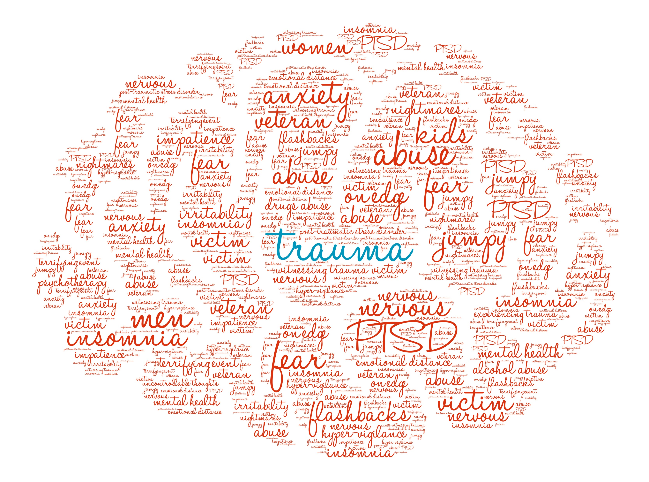
Tobacco Use and Trauma
Early initiation of tobacco use
Adult tobacco use
Duration and intensity of use
Increased risk of smoking in adulthood
Trauma
Adverse childhood experiences (ACEs)
Post-traumatic stress disorder (PTSD)
Individuals who experience trauma in early adulthood are twice as likely to smoke than those who have not experienced trauma
Notes:
Slide Animations
Well established research has shown that early initiation of tobacco use, adult tobacco use, duration and intensity of use and increased risk of smoking in adulthood is highly correlated to *click* past trauma experienced by individuals, including Adverse childhood experiences (ACEs) and Post-traumatic stress disorder (PTSD).
Trauma results from an event, series of events, or set of circumstances experienced by an individual as physically or emotionally harmful or life threatening, and has lasting adverse effects on the individual’s functioning and mental, physical, social, emotional or spiritual well-being.
Long-term side effects of trauma can include other MH/SUDs, such as depression and anxiety, and use of tobacco products may occur as a result of negative coping mechanisms and self-medication.
Among individuals who have experienced ACEs, the number of events experienced (or ACEs score) directly correlates with increased smoking prevalence.
In addition to a dose-response relationship between ACEs and adult smoking, reports have shown that exposure to trauma in early adulthood , is associated with up to a two-fold increased risk of smoking. *CLICK*Meaning individuals who experience trauma in early adulthood, are twice as likely to smoke than those who have not experienced trauma.
This rate may be higher in individuals who experience PTSD, who have been shown to have current cigarette smoking and nicotine dependence rates two to three times higher than the general population.
Additional info on ACES and tobacco use can be found in section 1 appendix of PM 53.

Slide 17
Tobacco and Opioids
High rate of co-use = Recovery from either substance more difficult
Similarly stimulate reward pathways in the brain, causing these addictions to be mutually reinforcing, meaning…
  Smoking increases opioid use, including opioid MAT
  Opioid use (including prescription MAT) reinforces smoking patterns
Chronic pain – Ongoing smoking becomes a risk factor for onset or exacerbation of back pain, sciatica, arthritis, fibromyalgia, and chronic headache.
  Sensitize pain receptors
  Decrease pain tolerance
  Increase pain awareness
Patients seeking outpatient pain treatment were over 7x more willing to consider quitting smoking when educated about the relationship between pain and tobacco use
Notes:
While the United States is in the midst of an opioid epidemic, tobacco use remains the leading cause of preventable death and disability.
Around 83- 95% of patients in treatment for opioid use disorder currently smoke cigarettes – this is an extremely high rate of co-use, which can lead to increased use of one or both substances making recovery from either substance more difficult.
Both opioids and tobacco similarly stimulate the reward pathways in the brain, causing these addictions to be mutually reinforcing meaning…
Smoking increases opioid use, including opioid replacement medication use (methadone)
While at the same time, Opioid use (including prescription replacement drugs) reinforces smoking patterns.
*click* Additionally, for those who experience Chronic pain –
ongoing smoking becomes a risk factor for the onset or exacerbation of back pain, sciatica, arthritis, fibromyalgia, and chronic headache.
Nicotine (or perhaps another component in tobacco smoke) may sensitize pain receptors, decrease pain tolerance, and increase pain awareness
persons that smoke or use tobacco products are at increased risk for chronic pain of higher intensity, increased number of painful sites, and more associated disability and adverse effects on occupational and social functioning.
*click* It’s clear that behavioral health treatment facilities need to address patient’s tobacco use as well as their substance use disorder. Patients seeking outpatient pain treatment were over 7x more willing to consider quitting smoking when educated about the relationship between pain and tobacco use
Sources:
Spiga R, Martinetti MP, Meisch RA, Cowan K, Hursh S. Methadone and nicotine self-administration in humans: a behavioral economic analysis. Psychopharmacology (Berl). 2005 Mar;178(2-3):223-31. doi: 10.1007/s00213-004-2020-6. Epub 2004 Oct 30. PMID: 15526094.
Elkader AK, Brands B, Selby P, Sproule BA. Methadone-nicotine interactions in methadone maintenance treatment patients. J Clin Psychopharmacol. 2009 Jun;29(3):231-8. doi: 10.1097/JCP.0b013e3181a39113. PMID: 19440076.
.Hooten WM, LaRowe LR, Zale EL, et al. Effects of a brief pain and smoking cessation intervention in adults with chronic pain: a randomized controlled trialber. Addictive Behaviors. 2019;92:173-179.

Slide 18

What We Know
Smoking exacerbates symptoms of behavioral health conditions:
    Greater depressive symptoms
    Greater likelihood of psychiatric hospitalization
    Increased suicidal behavior
    Drug and alcohol-use relapse
Tobacco cessation can have mental health benefits
Tobacco dependence treatment, during addictions treatment, is associated with a 25% increased likelihood of long-term abstinence from alcohol and illicit drugs.
Compton W. The need to incorporate smoking cessation into behavioral health treatment. The American Journal on Addictions.2018;27(1):42–43
Prochaska JJ, Das S, Young-Wolff KC. Smoking, Mental Illness, and Public Health. Annu Rev Public Health. 2017;38:165–185.doi: 10.1146/annurev-publhealth-031816-044618.
Weinberger AH, Platt J, Esan H, Galea S, Erlich D, Goodwin RD. Cigarette smoking is associated with increased risk of substance usedisorder relapse: a nationally representative, prospective longitudinal investigation. The Journal of Clinical Psychiatry. 2017;2(78):e152.
Notes:
About slide:
Smoking actually worsens symptoms of behavioral health conditions.
Smoking is associated with worse symptoms and outcomes among people with behavioral health conditions, including greater depressive symptoms, greater likelihood of psychiatric hospitalization, increased suicidal behavior, and drug- and alcohol-use relapse.
Quitting smoking is associated with an increase in long-term abstinence from alcohol and other drugs and a reduction in substance use disorder relapse.
*Click**Animation* Tobacco dependence treatment, during addictions treatment, is associated with a 25% increased likelihood of long-term abstinence from alcohol and illicit drugs. (Prochaska)
Flipping that -> So the narrative here may also be that quitting smoking is associated with a decrease in depression, anxiety and stress and of course improves a person's quality of life. In addition to the health benefits, of course there, quitting does not interfere with treatment, it doesn't worsen or impede recovery from substance use disorders. It's quite the opposite. Quitting smoking could make relapse less likely – and if you take anything away from today, quitting smoking, getting tobacco treatment during other addictions, treatment is associated with up to a 25% increase likelihood and long-term recovery from alcohol and other substances. Again, tobacco treatment during addictions treatment is preferred. It's linked to up to a 25% increase in long term recovery from alcohol and other substances.
Sources:
Compton W. The need to incorporate smoking cessation into behavioral health treatment. The American Journal on Addictions.2018;27(1):42–43
Prochaska JJ, Das S, Young-Wolff KC. Smoking, Mental Illness, and Public Health. Annu Rev Public Health. 2017;38:165–185.doi: 10.1146/annurev-publhealth-031816-044618.
Weinberger AH, Platt J, Esan H, Galea S, Erlich D, Goodwin RD. Cigarette smoking is associated with increased risk of substance usedisorder relapse: a nationally representative, prospective longitudinal investigation. The Journal of Clinical Psychiatry. 2017;2(78):e152.

Slide 19
Myths About Smoking and Behavioral Health Consumers
“Tobacco is necessary self-medication”
  Fact: industry has supported this myth
“They are not interested in quitting”
  Fact: same % wish to quit as general population
“They can’t quit”
  Fact: quit rates same or slightly lower than general population
“Quitting worsens recovery from the mental illness”
  Fact: not so; and quitting increases sobriety for individuals with alcohol use disorder
“It is a low priority problem”
  Fact: Tobacco-related diseases are the biggest killer for those with mental illness or substance use disorder.
Source: Prochaska, NEJM, July 21, 2011
Notes:
Think back on our slide about the tobacco industries influence on these populations as we talk a look at some of the myths about smoking and BH
Tobacco is necessary self-medication
Click*Fact: The tobacco industry has fostered this belief by funding research and presentations on the self-medication hypothesis, supporting opposition to the JCAHO smoking ban, publishing articles in the lay press, and marketing cigarettes to people with mental illness
They are not interested in quitting
Click*Fact: Research argues otherwise: studies involving patients recruited from outpatient and inpatient psychiatric settings suggest that they are about as likely as the general population to want to quit smoking. 1 In the United States, 20 to 25% of persons that smoke or use tobacco products report that they intend to quit smoking in the next 30 days, and another 40% say they intend to do so in the next 6 months. Furthermore, among persons that smoke or use tobacco products with mental illness, readiness to quit appears to be unrelated to the psychiatric diagnosis, the severity of symptoms, or the coexistence of substance use
They can’t quit
Click*Fact: Although treating tobacco dependence is challenging, several randomized treatment trials and systematic reviews involving persons that smoke or use tobacco products with mental illness have documented that success is possible.
Quitting worsens recovery from the mental illness
Click*Fact: not so; and quitting increases sobriety for individuals with alcohol use disorder. Smoking cessation did not worsen depression or PTSD symptoms or lead to psychiatric hospitalization or increased use of alcohol or illicit drugs
It is a low priority problem
Click*Fact people with psychiatric disorders are far more likely to die from tobacco-related diseases than from mental illness. persons that smoke or use tobacco products know tobacco use has deadly consequences and expect health care professionals to intervene. Indeed, raising the issue of tobacco use with patients enhances the rapport between patients and clinicians
Source: Prochaska, NEJM, July 21, 2011

Slide 20
Diagnostic and Statistical Manual of Mental Disorders,
5th edition (DSM-5): Tobacco Use Disorder*
DIAGNOSTIC CRITERIA*
1. Persistent desire or unsuccessful efforts to quit or cut down | 7. Giving up or reducing important activities because of use
2. Great deal of time spent to obtain or use tobacco | 8. Repeated use in hazardous situations
3. Craving, or a strong desire or urge to use tobacco | 9. Continued use despite persistent physical or psychological problems attributed to tobacco use
4. Taken in larger amounts or over a longer period than intended | 10. Tolerance
5. Continued use despite adverse social or interpersonal problems | 11. Withdrawal symptoms upon cessation of use
6. Recurrent use resulting in failure to fulfill major responsibilities and obligations
*Diagnosis requires two or more symptoms over a 12-month period
Notes:
Tobacco use disorder is defined as “a problematic pattern of tobacco use leading to clinically significant impairment or distress, as manifested by at least two of the following, occurring within a 12-month period”.
ASK: Does this criteria look similar to other substance use criteria? Do any of these symptoms stand out to you? (Very similar to alcohol use disorder)
TUD has been in the DSM since 1980, is the most prevalent and most deadly SUD however, it is rarely treated as other SUDs
American Psychiatric Association. (2013). Diagnostic and statistical manual of mental disorders (5th ed.). https://doi.org/10.1176/appi.books.9780890425596

Slide 21
Why Should Behavioral Health Clinicians Address Tobacco?
Tobacco users expect to be encouraged to quit by health professionals. Screening for tobacco use and providing tobacco cessation counseling are positively associated with patient satisfaction.
Often the clinician for whom contact is the most frequent and who knows the patient best.
Tobacco Use Disorder is the most prevalent substance use disorder and is a DSM-V Substance Use Disorder.
Trained in motivational interviewing.
Able to combine psychopharmacological and behavioral counseling treatment.
Failure to address tobacco use tacitly implies that
quitting is not important.
Barzilai et al. (2001). Prev Med 33:595–599; Conroy et al. (2005). Nicotine Tob Res 7 Suppl 1:S29–S34.
Notes:
So why should behavioral health clinicians address tobacco?
Tobacco use disorder most prevalent SUD! And who better to treat this than BH clinicians who deal with substance use disorders regularly.
Tobacco use disorder is DSM-5 disorder, and those that treat MH & SUD have the skills to treat TUD since the interventions are the same - since TUD is a SUD.
Really this is a primary setting for treating folks with Tobacco Use disorder – we’re able to combine psychopharmacological and behavioral counseling
*click* And then failure to address tobacco use implies that quitting is not that important.
About slide:
Tobacco users expect to be encouraged to quit by health professionals, including behavioral health providers. A study determined that of 12 health habits examined (exercise, diet, alcohol history, alcohol counseling, tobacco history, tobacco counseling, passive tobacco exposure, contraception and condom use, substance use history, substance use counseling, STD prevention, and counseling about HIV testing or prevention), only tobacco history and tobacco counseling were significantly associated with full satisfaction with the clinician visit. A clinician who does not address tobacco use during a clinical encounter tacitly implies that quitting is not important.
BH clinicians are often the clinician for whom contact is the most frequent and who knows the patient best.
Trained in substance abuse treatment. Tobacco Use Disorder is a DSM-V Substance Use Disorder. TUD is the most common form of SUD and has been in the DSM since 1980 -- however remains the most under-diagnosed and un-treated SUD
Trained in motivational interviewing. MI is a great strategy for working with clients who are ambivalent about quitting.
Able to combine psychopharmacological and behavioral counseling treatment.
Suggested literature review: Snuffing out tobacco dependence. Ten reasons behavioral health providers need to be involved, by Jill Williams, MD, and Douglas M. Ziedonis, MD, MPH -http://www.behavioral.net/article/snuffing-out-tobacco-dependence
Reasons for BH providers to address tobacco use
Treating tobacco dependence saves lives and improves quality of life
Treating tobacco-dependence is cost- effective and saves healthcare dollars.
Treating tobacco dependence improves employee productivity and health.
Smoking disproportionately affects people with behavioral health problems.
Tobacco Use Disorder is a DSM-V Substance Use Disorder
Tobacco dependence and mental illness are SAMHSA-defined co-occurring disorders.
Behavioral health practitioners have more time than primary care providers for psychosocial treatments for tobacco dependence
Tobacco use interferes with psychiatric medications.
Barzilai DA, Goodwin MA, Zyzanski SJ, Stange KC. (2001). Does health habit counseling affect patient satisfaction? Prev Med 33:595–599.
Conroy MB, Majchrzak NE, Regan S, Silverman CB, Schneider LI, Rigotti NA. (2005). The association between patient-reported receipt of tobacco intervention at a primary care visit and smokers’ satisfaction with their health care. Nicotine Tob Res 7 Suppl 1:S29–S34.

Slide 22
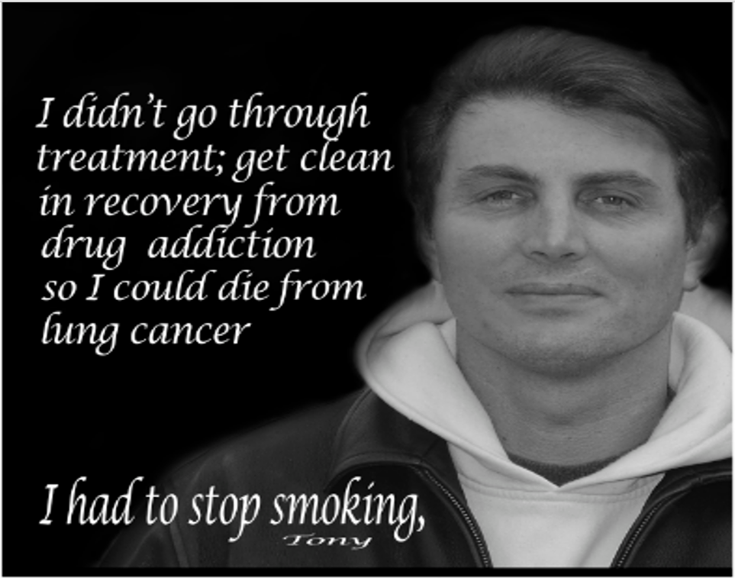
Notes:
This is Tony, he is a real consumer. This campaign was created by the Wisconsin Nicotine Treatment Integration Project, funded by the Wisconsin Division of Public Health.

Slide 23
Tools for Tobacco Treatment
Notes:
I think it is worth repeating that TUD is the most prevalent SUD and is deserving of the same treatment - however people with TUD are expected to slap on a patch and quit or even quit cold turkey. Why is this? This is especially concerning because fewer than 5% of quit attempts are successful when people try to quit on their own.

Slide 24
Evidence-based Tobacco Treatment
5A’s (Ask, Advise, Assess, Assist, Arrange)
AAR (Ask, Advise, Refer)
Quitlines
NRT and other medications
Counseling and behavioral change strategies
Peer-to-peer intervention
Fiore MC, Jaén CR, Baker TB, et al. Treating Tobacco Use and Dependence: 2008 Update. Clinical Practice Guideline. Rockville, MD: U.S. Department of Health and Human Services. Public Health Service. May 2008.
Notes:
So now I’m going to share some evidence-based tobacco treatment interventions that anyone can do:
The 5A’s and AAR are forms of brief interventions. I’d like to point out that there is a dose response relationship…the more intensive the treatment, the better the outcome - however, even brief intervention is better than nothing.
As a note, RTI has some scripts available for you to help with how to ASK and ADVISE because our words matter. I’ll give you some scripting in just a couple of slides. Speaking of our words and that they matter, you will notice that we aim to use them terminology of TUD, and tobacco treatment or tobacco recovery, instead of smokers and smoking cessation. And I invite you to use this same language.
There are various evidence-based tobacco treatment interventions, and most of these are interventions behavioral health professionals are already skilled in delivering (such as MI, cognitive/behavioral strategies, coping mechanisms, and shared decision making)
Treatments that combine tobacco treatment medications with cognitive behavioral interventions have the best rates of treatment acceptance and effectiveness (25-30% abstinence rate) (Fiore & Baker, 2011). Currently we have 7 FDA approved medications to assist people with TUD. Think of these as MAT. (medication assisted treatment)

Slide 25

Ask-Advise-Refer (AAR)
AAR is an evidence-based brief intervention model for addressing tobacco use and dependence.
Referral to resources such as community pharmacies and the Quit Now Indiana services.
Can be completed in less than 5 minutes – even a brief intervention increases patient interest and success in quitting
Healthcare professionals play a critical role in
helping patients to quit using tobacco
Notes:
Healthcare professionals play a critical role in helping patients to quit using tobacco and should utilize Ask-Advise-Refer or AAR model at a minimum, when time or logistics do not allow for intensive tobacco treatment counseling during a patient visit - again, since even brief interventions have been shown to be effective and can be achieved in less than 5 mins.
So what is ASK, ADVISE, Refer? CLICK

Slide 26

ASK
Every Patient / Every Visit
Ask all patients about their tobacco use, including e-cigarette/vaping products, and document in your agency’s electronic health record (EHR).
Start the conversation by asking permission:
“Would you mind if I asked you a few
questions about your tobacco use?”
  “We like to have this information so we can check for any potential interactions with tobacco and your other medicines.”
  “Many illnesses are caused, or worsened, when people smoke, vape, or use tobacco.”
  “We care about your health, and we have resources to help our patients quit.”
Notes:
In order to provide treatment or connect to appropriate resources, it’s essential to first begin identifying your patients who use tobacco products, including e-cigarettes or vape products. Asking ALL patients about their tobacco at every visit, and then documenting their status in your agency’s EHR, will help to ensure all patients are offered treatment or connected to resources to help quit, since we know that it can take several tries for someone to quit tobacco successfully.
Asking about tobacco use should be considered to be as important as evaluating vital signs or obtaining a medication history. And screening for tobacco use and providing tobacco treatment counseling are positively associated with patient satisfaction. CLICK
Consider starting the conversation by asking for your patient’s permission to discuss their tobacco use. Asking permission can help to reduce discord or unpleasant feelings patients may have about the topic of tobacco. Consider asking, “Would you mind if I asked you a few questions about your tobacco use?” then you can give a reason such as… CLICK
We like to have this information so we can check for any potential interactions with tobacco and your other medicines”. CLICK
“Many illnesses are caused, or worsened, when people smoke, vape, or use tobacco products.” CLICK
“We care about your health, and we have resources to help our patients quit”
This lets the patient know that we are concerned about their tobacco use and how it may impact their treatment and health.

Slide 27

ASK
Every Patient / Every Visit
Ask about tobacco use using a nonjudgmental tone:
  “Tobacco use can significantly impact [insert specific mental health condition/recovery], so we ask all our patients about their experience using tobacco products.”
  “What tobacco products, including e-cigarettes/vapes like JUUL or puff bars, have you used in the last 30 days?”
  “Do you smoke or use any type of tobacco or nicotine, such as e-cigarettes?”
  “I wanted to touch base and see if there has been any change in your tobacco use since your last visit?”
Notes:
*CLICK* After asking permission, ask your patients about their tobacco use. Be sure to use a nonjudgmental tone that conveys sensitivity compassion and concern.
Consider using these scripts: CLICK
“Tobacco use can significantly impact [insert specific mental health condition/recovery], so we ask all our patients about their experience using tobacco products. Do you ever smoke or use other types of tobacco products like e-cigarettes/vapes, cigars, or smokeless tobacco?” CLICK
“What tobacco products, including e-cigarettes/vapes like JUUL or puff bars, have you used in the last month?
“Do you, or does someone you know, smoke or use any type of tobacco or nicotine, such as e-cigarettes?”
Even if you see your patient frequently, it is still important to ask at every visit. People can move through the stages of change quickly or get stalled in addition to the fact they often try to quit, but relapse. Instead of going through the same conversation with a patient you do see frequently, just “check in” saying “I wanted to touch base and see if there has been any change in your tobacco use or thoughts of quitting since your last visit?”
If your patient does NOT use tobacco, reinforce their continued abstinence. If they do use tobacco, engage your patient in further discussion to learn more about their experience using tobacco. Having additional information can help you gain a deeper understanding of your patient’s unique relationship with tobacco and allow you to better support their journey to tobacco recovery

Slide 28

Tips for Asking About Tobacco Use
Use a non-judgmental tone of voice
Convey sensitivity, concern, and respect
Ask about ALL tobacco products – may need to specify the specific brand name of the product
Notes:
So remember when asking about tobacco use, use a non-judgmental tone of voice. You want to convey sensitivity, compassion, concern, and respect for your patient.
And make sure you ask about ALL tobacco products which includes e-cigarettes, pipe, smokeless tobacco, pouches, cigars and even hookah. Many people don’t consider all of these to be tobacco products, especially e-cigarette and pouch users.
You may need to ask about specific brands such as JUUL, Puff Bars, or Zyn are some products more commonly used by youth.

Slide 29

ADVISE
All Patients Who Use Tobacco to Quit
Advise all patients who use tobacco products (including e-cigarette products) to quit
Provide clear and personalized suggestions to quit such as:
  “Quitting smoking is an important part of your overall recovery. Quitting while you’re in treatment for SUD can help make the recurrence of symptoms less likely.”
Notes:
Next, You should strongly advise all patients who use tobacco products to quit. At the very least, these patients should be advised to consider quitting.
CLICK The message should be clear and strong, yet personalized and sensitive, making sure to not have a judgmental tone. Advising patients to quit should be done in a way that shows concern for their well-being and commitment to help them quit when they are ready!
Next are some examples of clear and personalized suggestions to quit: CLICK
““Quitting smoking is an important part of your overall recovery. Quitting while you’re in treatment for FILL IN THE BLANK can help make the recurrence of symptoms less likely.

Slide 30

ADVISE
All Patients Who Use Tobacco to Quit
  “There’s still a lot we don’t know about vaping, but we do know that vapes contain some of the same cancer-causing chemicals (e.g. formaldehyde) that cigarettes have in them. People who use proven methods to quit like medications (e.g. NRT) combined with counseling, can nearly triple their odds of quitting successfully!”
  “Quitting smoking is one of the most important things you can do to improve your health.”
Notes:
When it comes to vaping, there is still a lot of confusion about these products but if they contain nicotine, they are deemed by the FDA as a tobacco product. They are not an aide to help people with quitting cigarettes.
So the best way to respond to those that are vaping would be something like this: “There’s still a lot we don’t know about vaping, but we do know that vapes can contain some of the same cancer-causing chemicals (e.g. formaldehyde) that cigarettes have in them. People who use proven methods to quit like medications (e.g. NRT) combined with counseling, can nearly triple their odds of successfully quitting!”
“Quitting smoking is the most important thing you can do to improve your mental health. What are your thoughts?”

Slide 31

Tips for Advising Patients to Quit
Use a non-judgmental tone of voice
Advice to quit should be clear and strong
Personalize the message to quit
Be empathic and offer support
Notes:
Again, when advising patients to quit tobacco, use a non-judgmental tone of voice. The advice to quit should be clear and strong and personalized whenever possible.
Try linking the message to quit to other reasons you may be treating your patient.
Remember to be empathic and offer support when they are ready. Offering support is critical as well as letting them know that people often need many attempts to quit for good.
Utilizing motivational interviewing skills can help guide this conversation. Let the patient know that this is very important issue and you will be having this conversation again when they return.

Slide 32
REFER
Refer Patients to Community Resources or Programs to Help Quit
Know your local resources and programs (e.g. classes, support groups), including:
  Quit Now Indiana (https://www.quitnowindiana.com)
  Quit Smoking Pharmacies https://www.quitsmokingpharmacies.com/quit-smoking-pharmacies
  www.SmokeFree.gov
Notes:
After advising patients who use tobacco products to quit -
If they are interested in quitting, are considering making a change or if they’re uncertain about quitting, refer them to Quit Now Indiana quit services, an addictions therapist, or a tobacco treatment specialist!
Many pharmacists (including Genoa, Kroger, Costco) in Indiana have prescriptive authority to prescribe tobacco treatment products for patients! To find a pharmacy, go to Quit Smoking Pharmacies at the link on the screen
Also, those of you that are affiliated with Genoa pharmacies, could refer to their staff who have received additional training in tobacco treatment. They can provide brief counseling interventions and recommendations on pharmacologic therapies
There are also a number of resources that can be found at smokefree.gov

Slide 33
Sample Referral Scripts
“If you’d like, I can share some information about the Quit Now Indiana services which offers free help to Hoosiers. How do you feel about that?”
“You’ve mentioned you’ve tried to quit smoking several times, but have you ever been part of any tobacco counseling program? A quit coach could make a huge difference! Quit Now Indiana quit services offers free support with a quit coach. The quitline also offers free medications. Are you willing to give that a shot?”
“The easiest way to quit tobacco is by getting counseling support along with medications. Our pharmacy partners can talk with you about a quit plan and discuss medication options to see which one would work best for you. How does that sound?”
Notes:
Here are some sample referral scripts– and you should try and make it your own as you work with your patients.
It could be something like, you know,
“If you’d like, I can share some information about the Quit Now Indiana services which offers free help to Hoosiers. How do you feel about that?”
Or maybe
“The easiest way to quit tobacco is by getting counseling support along with medications. Our pharmacy partners can talk with you about a quit plan and discuss medication options to see which one would work best for you. How does that sound?”

Slide 34
Tobacco Treatment Interventions
The Clinical Practice Guidelines for Treating Tobacco Use and Dependence strongly recommends the combination use of tobacco treatment medications and behavioral counseling
  Combining medications and counseling are more effective than either treatment alone.
  Tobacco dependence treatments are both clinically and cost-effective.
Treatment | Quit Rate
Unaided/No Help | 4-7%
Self-help | 11-14%
Quitline | 11-15%
Individual counseling | 15-19%
Group counseling | 12-16%
Medication alone | 22%
Medication + Counseling | 25-30%
Fiore MC, Jaen CR, Baker TB, et al. (2008). Treating Tobacco Use and Dependence: 2008 Update. Clinical Practice Guideline. Rockville, MD
Notes:
When people try to quit on their own, fewer than 5% of quit attempts are successful, however, there are many different evidence-based options for tobacco cessation.
Treatments that combine tobacco cessation medications and behavioral counseling have the GREATEST chances of treatment acceptance and success!
Combining both medications and counseling are more effective than either treatment alone. They are also cost-effective.

Slide 35
Resources
Notes:
Now I’d like to invite you to review some resources where you can find more information

Slide 36
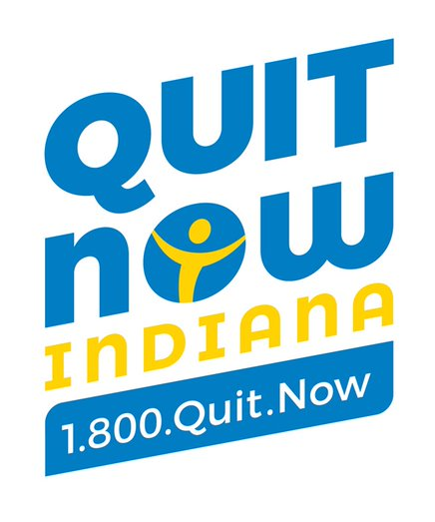
Behavioral Health Program
Behavioral Health Program includes:
Programs by Population | PLUS the Following:
7 Prearranged calls with Quit Coach for Behavioral Health consumers. Quit Coaches have received additional training on mental illness and tobacco cessation. | Free 12-week regimen of combination therapy NRT (patch + gum or lozenge) Letter sent to MH provider informing of quit attempt Unlimited call-ins to the ITQL Text messages to connect with Quit Coach Access to online tools, videos, and educational materials on www.QuitNowIndiana.com
Notes:
About Slide: You may have heard about the Quit Now Indiana services…
This program includes higher intensity behavioral and pharmacological support for callers with a behavioral health condition.
These enhanced services include 7 prearranged calls from their quit coach, and these Quit Coaches have received additional training on mental health conditions and tobacco cessation.
In addition to the increased number of calls, those who enroll in the behavioral health program with the quitline receive FREE 12 week regimen of combination therapy NRT – Combination NRT is recommended by the Clinical practice guidelines and has shown increased rates of long-term abstinence over monotherapy.
And lastly, enrolled callers will have a letter sent to the provider designated by the participant, informing the provider of the patient’s quit attempt. Participants also receive access to the other services and resources shown here.
The caveat is that they have to disclose that they have a behavioral health condition.
I will also say that it can be challenging to get patients with bh challenges to feel comfortable using these services

Slide 37
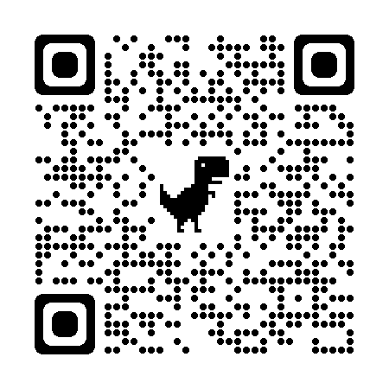
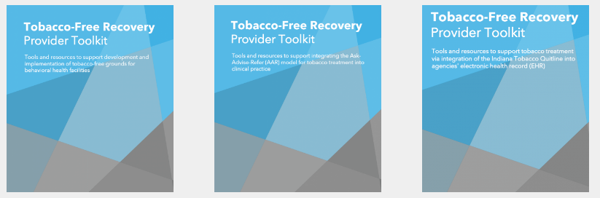
Resources
Rethink Tobacco Indiana Website
One-on-One Technical Assistance
Educational Videos for providers and patients
Staff Training
Toolkits
Notes:
As I mentioned at the beginning, Rethink Tobacco Indiana is grant funded so we can provide one-on-one technical assistance for any agency. We are here to help through the process every step of the way from start to finish.
We also help with staff Training and this can be done via webinars, videos, or tailored programming to meet your needs
In addition, we have created toolkits to assist agencies as well. We have a toolkit for conducting tobacco free grounds work, for implementing Ask-Advise-Refer, and a toolkit for health systems change work. Each of these helps to guide systems through the process and has numerous resources that agencies can adapt to their environment, so there isn’t a need to create materials and resources from scratch. You can use this QR code to access these resources

Slide 38
Tobacco Treatment Specialist (TTS)
A Tobacco Treatment Specialist (TTS) is a professional who is specially trained to possess the skills and knowledge to provide effective, evidence-based interventions for tobacco dependence for all forms of tobacco and nicotine use.
Tobacco Treatment Specialists are equipped to develop individualized treatment plans using comprehensive, evidence-based assessments and treatment strategies for individuals with tobacco use disorder within a health care or community setting.
Notes:
Another great resource is TTS training -- Touching on the Tobacco Treatment Specialist – a professional development opportunity
TTS training programs serve providers from many different professions & clinical settings (this could include Resp Therapists, Nursing, Mental Health & addictions counseling, social work, pharmacy, Peer specialists, and lay people)
TTS training programs deliver foundational information and skill-building on the science behind tobacco addiction, nicotine withdrawal symptoms and evidence-based treatments (i.e. MI, CBT, Relapse prevention and Pharmacotherapy)
Develop grads who provide clear and accurate information about tobacco product use, the causes and consequences of tobacco use, and are then able to work with clients collaboratively to create treatment plans for individuals and communities
In the US, there are currently 23 accredited TTS training programs. Accreditation is important because it provides external validity and is a form of quality control assuring that graduates have met required standards in 11 Core Competencies. Accreditation is rigorous, highly-valued and equivalent to a Master’s Degree.
Once a person has successfully completed an accredited TTS course, they can pursue the National Certificate in Tobacco Treatment Practice

Slide 39

Tobacco Treatment Specialist (TTS) Core Training
TTS Part 1 – Prerequisite to Part 2
  8-10 hour online course that must be completed prior to attending the virtual 3-day Part 2 training
TTS Part 2
  3-day evidence-based training program, delivered virtually via Zoom
Final Exam
  Part 1: 100 multiple choice questions (3hr time limit)
  Part 2: One case study (1hr time limit)
Notes:
This training consists of 2 parts:
Part 1 is asynchronous and covers the determinants of tobacco use disorder, including biological, psychological, and social aspects; physical and behavioral health impact of tobacco use; and best practices for systems to support treatment of tobacco use disorder. This MUST be completed before attending Part 2
Part 2 is live but virtual and consist of 3 full training days. Topics will include pharmacotherapy; counseling skills such as motivational interviewing; cognitive and behavioral strategies to assist tobacco users in quitting; and intake, assessment, and treatment planning.
Once the course is completed, there is a final exam completed online through Umass – the University of Massachusetts as we utilize their training program. Once one has completed the TTS Training AND passed the online exam we encourage you to apply for the National Certificate in Tobacco Treatment Practice!

Slide 40
National Certificate in Tobacco Treatment Practice (NCTTP)
Created to standardize and unify tobacco competencies, knowledge, and skills on a national level and provides national, unified recognition of professionals who obtain this prestigious certificate.
Demonstrates advanced education in evidence-based tobacco treatment competencies, skills, and practice.
For more information, FAQs, and to apply go to www.naadac.org/NCTTP
Notes:
The National Certificate in Tobacco Treatment Practice (NCTTP) is a national credential, and it is currently non-renewable
Though this certification may have implications regarding billing for services in the future
Additionally, possession of the NCTTP will hopefully provide a smooth 'grandfathering’ option to ultimate national certification as this continues to evolve

Slide 41
Rethink Tobacco Indiana’s 6-hr Tobacco-Free Recovery Workshop
Designed for those who interact with persons with behavioral health conditions and have an interest in learning about evidence-based tobacco treatment strategies.
Learning Objectives:
Describe how tobacco use impedes recovery from behavioral health conditions
Review medications and cognitive and behavioral strategies to assist tobacco users
Review evidence-based tobacco treatment strategies and recommendations
Who should attend:
• Addictions counselors
• Mental health counselors
• Peer support specialists
• Nurses
• Pharmacists
• Physicians
• Social workers
Notes:
This 6- hour Tobacco Free Recovery Workshop is designed as a brief version of the Tobacco Treatment Specialist (TTS) training course.
This workshop is designed for those who interact with persons with behavioral health conditions and have an interest in learning about evidence-based tobacco treatment strategies.
Objectives:
1. Review tobacco use prevalence among adults in the U.S. and Indiana
2. Describe the criteria for Tobacco Use Disorder, including nicotine withdrawal symptoms
3. Recognize the relationship between tobacco use and behavioral health conditions
4. Discuss the negative impact of tobacco use on recovery
5. Discuss evidence-informed counseling strategies for tobacco use and dependence
6. Demonstrate understanding of counseling strategies through case-based discussions
7. List the seven FDA-approved medications with indication for smoking cessation and describe standard dosing.
8. Summarize recent data describing the efficacy of tobacco treatment medications, including combinations therapy, for treating tobacco use and dependence.
9. Describe the services and programs offered by the Indiana Tobacco Quitline, including the steps to initiate a referral.
10. Share tools and local and national resources related to tobacco treatment.

Slide 42
Summary
Tobacco use disparities exist. Smoking rates are 3 to 5 times higher among persons with mental illness or SUD, compared to that of the general population.
Approximately half of all tobacco-related deaths each year are among persons with behavioral health conditions.
Tobacco use exacerbates symptoms of behavioral health conditions and negatively affects treatment and recovery. Tobacco treatment, during addictions treatment is associated with a 25% increase in long-term recovery and overall patient outcomes.
Indiana has an overwhelming burden of premature death, disease, and disability from high tobacco use rates.
To maximize success, tobacco cessation interventions should include behavioral counseling and one or more tobacco treatment medications.
Behavioral health treatment facilities should adopt and implement TF-free grounds policies and integrate tobacco treatment into services.
Notes:
So in summary…
Tobacco use disparities exist. Smoking rates are 3 to 5 times higher among persons with mental illness or SUD, compared to that of the general population.
Approximately half of all tobacco-related deaths each year are among persons with behavioral health conditions.
Tobacco use exacerbates symptoms of behavioral health conditions and negatively affects treatment and recovery. Tobacco treatment, during addictions treatment is associated with a 25% increase in long-term recovery and overall patient outcomes.
Indiana has an overwhelming burden of premature death, disease, and disability from high tobacco use rates.
To maximize success, tobacco cessation interventions should include behavioral counseling and one or more tobacco treatment medications.
Behavioral health treatment facilities should adopt and implement TF-free grounds policies and integrate tobacco treatment into services.

Slide 43
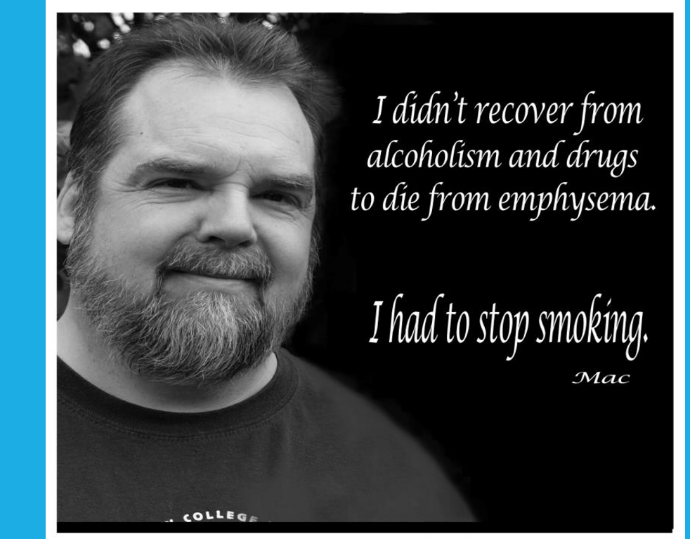
Notes:
As we wrap up, I’d like to leave you with a quote from a real consumer, this is Mac.

Slide 44

Contact Info
QUESTIONS
Debi Buckles
RTI Project Director
dhudson@iu.edu
www.RethinkTobaccoIndiana.org

